Slide 1
Innovative and Interactive Public Involvement for the 21st Century 2015 Partnering Conference
Brian Aldridge, Stantec
Charlie Allen, KYTC District 4
Annette Coffey, Qk4
Sreenu Gutti, CO Planning
Shane Mckenzie, CO Planning
Jeff Moore, KYTC District 3

Slide 2
Workshop Agenda
State of the Practice: Public Involvement in the 21st Century
Panel Discussion
KYTC District Office
KYTC Central Office
Consultants (Qk4 and Stantec)
Activity: “We all scream for Ice Cream!”
Sticker Dot Exercise
$100 question Exercise

Slide 3
The Five “I’s” of Public Involvement

Slide 4
Public Involvement Beatitude
Blessed are the flexible for they will not get bent out of shape.

Slide 5
Panel Discussion:
In regards to the public involvement methods used in the US 68 (Metcalfe/Green) or US 31W/KY 446 Planning Studies and how the data collected informed the decision-making process-----
What were the lessons learned?
The only mistake in life is the lesson not learned. -- Albert Einstein

Slide 6
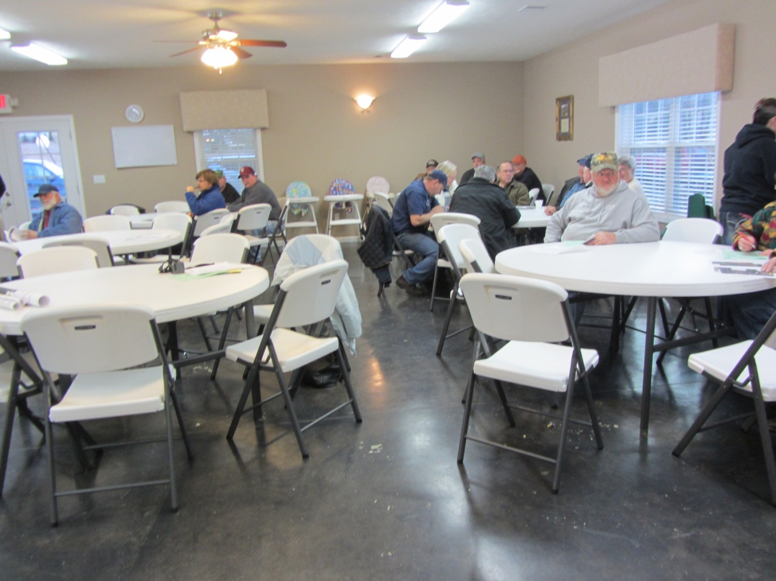
IDENTIFY & INVITE: Know Your Audience!

Slide 7
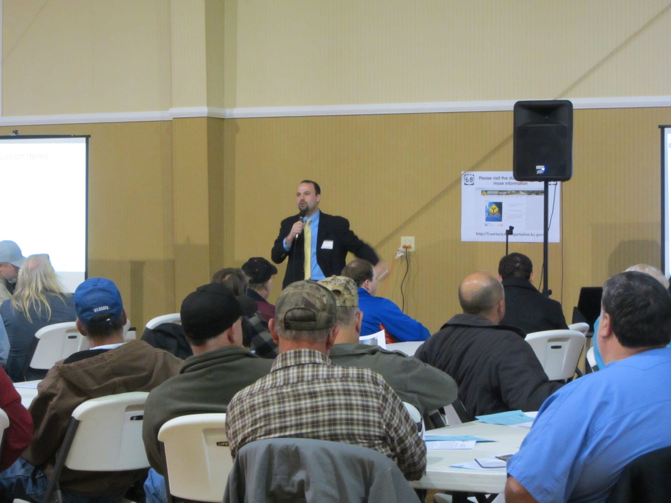
A Short Presentation Goes a Long Way

Slide 8
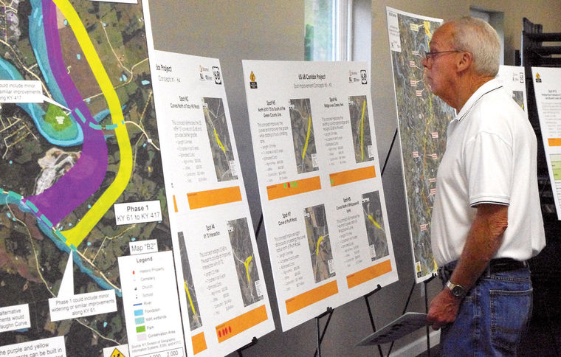
Give Meeting Attendees a “Job”
http://www.glasgowdailytimes.com/

Slide 9
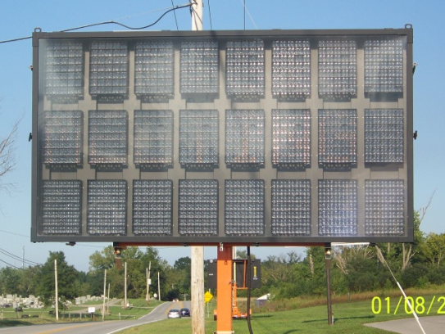
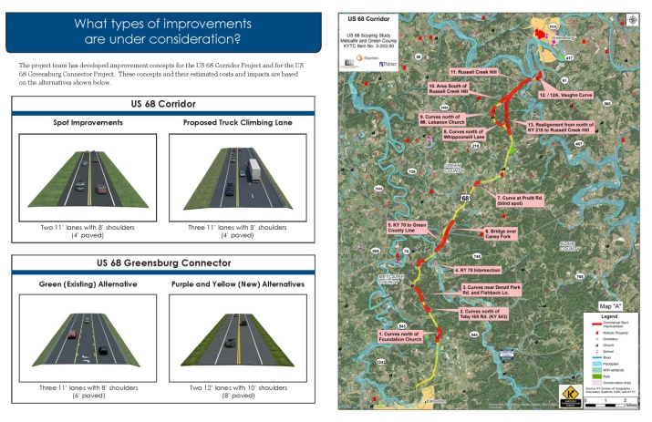
Outreach Techniques in getting the word out
Variable Message Signs
Display 2-3 weeks before meeting
Information Fliers or Brochures
Distribute at local businesses, public gatherings, etc.

Slide 10
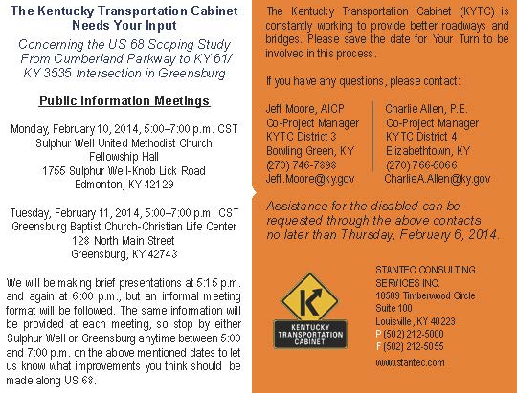
Media Outreach
Newspapers, Radio, KYTC website
Postcards
Send to impacted property owners
Video meeting invitation
“Call to Action” video -
NEW LIFE, NEW FUTURE

Slide 11
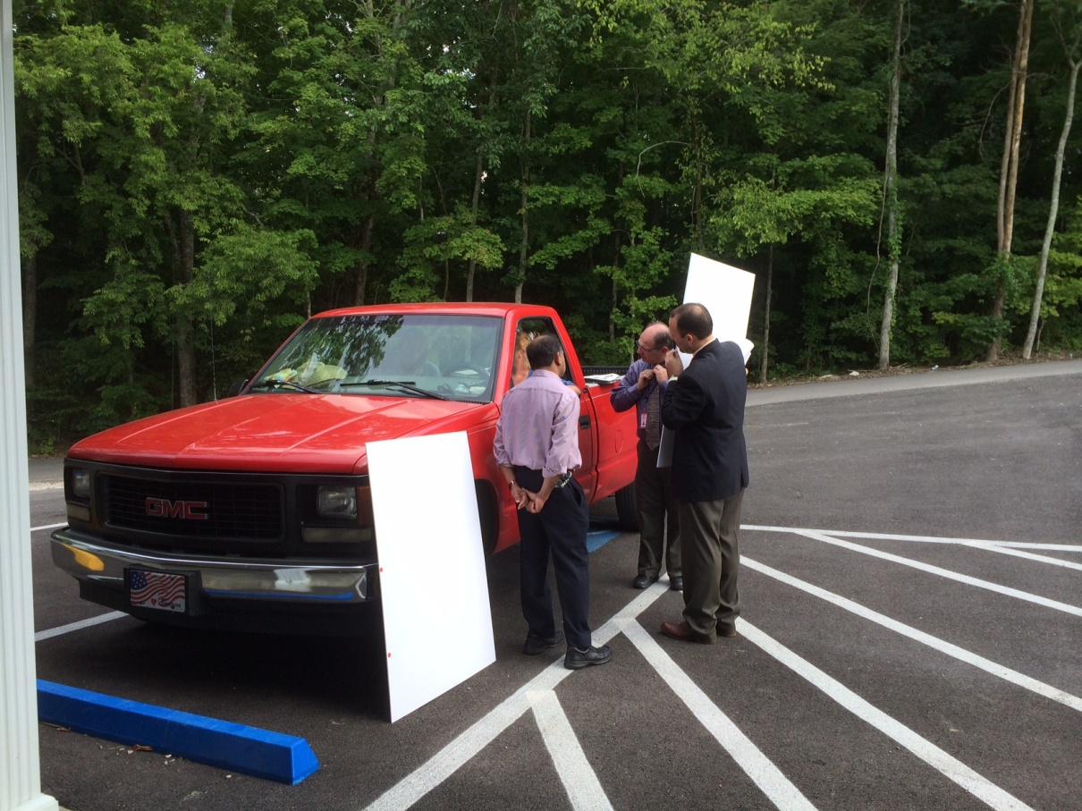
Do everything you can to get the word out!

Slide 12
INFORM: “MAKE NO ASSUMPTIONS!”
Two public meetings (Charlie A.);
Meeting 1: Issues & Concerns
* Provided a general overview of existing conditions and identified obvious issues.
* Allowed time for local officials and public to markup a map which resulted in 5 basic areas of concern for our corridor.
Meeting 2: Alternatives & Improvements
* The 5 areas helped us to identify 12 spot improvements and one off alignment option.
* Provided visualizations of each.

Slide 13
INFORM: “MAKE NO ASSUMPTIONS!”
Never assume the data tells the whole story. The locals know where the issues are and may offer great solutions.
Visuals should be conceptual and not appear to create a perception that an alignment has been determined.
Use more transparent shading of an area instead of defined lines.
Enough detail to assist with decision making and developing estimates but it’s too early in the process to create property owner concern.

Slide 14
INFORM: “MAKE NO ASSUMPTIONS!”
Preparing the team
Meeting flow in space:
Give clear instructions at beginning
Take 20 minutes just before meeting and gather the team:
“Open question and answer session” to brief the team on meeting details such as:
Task assignments: Greeters, Educators, Scribes, Map interpreters
Who among the team subject matter experts are to field specific questions from the public.
Coach the team to engage and encourage dialogue with the public
Write it down
Draw
Point

Slide 15
INFORM: “MAKE NO ASSUMPTIONS!”
Preparing the team
Meeting presentations:
Need two versions
Long form – continuous unmanned PowerPoint on loop
Short form – Live presentation
Present the project details in more than one way and man the room with well informed team members who are ready for a friendly and engaging information exchange with the public.

Slide 16
INVOLVE:
Electronic Surveys
Give Them a Job!

Slide 17
Start Thinking Early
Know what input you need and ask the right questions!
Discuss questions with the Project Team
Check your questions against the Purpose and Need for the project.
Collect email addresses

Slide 18
Inform: Prep their Participation
Project Purpose and Need
Where you are in the process.
Why you are collecting information.
What you are going to do with it.

Slide 19
Questions
Mirror your electronic and paper survey
Start with basic information
Who are they?
Is it important to know their age?
Do they travel the corridor?
Do they even live in the county?
Ask yourself what do you want to know from them?
Cemeteries
Family clusters
Farmers – in case you need a larger roundabout
Alignment preference
Make it easy! Give them Quick checkbox choices!

Slide 20
Remember
Keep it simple - 6-8 questions
Give them options but do not lead
Leave a short blank for “other”…at the end of each question…..
Minimize essay questions
“Catchall” essay question at the end
Provide your contact and phone number

Slide 21
Enhancements
Use a sliding scale of at least 1 to 5.
Always specify how to use it.
Include maps and pictures
% Complete at the bottom of each page.
Ask them to join a mailing list

Slide 22
Advertise the Survey
Website/URL in presentations,
Newspaper, TV, radio,
Paper surveys,
Post cards
Emails, and takeaways

Slide 23
Send and Follow-up
Send a quick email with hyperlinks using Sharefile, Dropbox, ftp site
Follow up with a reminder!
Enter your completed/mailed-in paper surveys into the electronic survey instrument for easier summaries.

Slide 24
Lessons Learned Test Case - Resource Agency Coordination
Let’s do it electronically!
Developed a survey to determine what survey method was best!
Still two methods
Hard copy letter (traditional) &
Electronic survey (tailored)
They were not the same.

Slide 25
Lessons Learned Test Case - Resource Agency Coordination
Hard copy
More difficult to summarize, report out, and compare when questions were not the same.
Seemed to receive more “canned” letters
Most did not go to the survey link in the letter
Sometimes received copy and paste paragraphs for other projects
Electronic copy
Easier
Killed a lot less trees
Electronic responses were informal, timely, efficient for the sender and effective.
Must track email addresses and save as pdfs!
Easy to send reminders through email
We received 9 responses after the deadline with just a quick reminder email and a link to the survey.
Set your deadline to be flexible.
Don’t forget the simple things Name, Title, representing and type of agency!

Slide 26
Activity: “We All Scream for Ice Cream!”
Sticker Dot Exercise
Select your most favorite (GREEN dot)
Select your second favorite (ORANGE dot)
Select your least favorite (PINK dot)
$100 question Exercise
If you were given 10 CENTS to purchase the container and the toppings for your ice cream, then how would you spend your 10 CENTS?

Slide 27
Follow-up Discussion
Each of the two “work-groups” will report out to the session participants their thoughts on the tools and applications.

